Slide 1




IMDb Mobile testing

Slide 2
The Project
Analyze IMDb application
Test all the features listed in the tasks:
Sign-in with IMDb account
Logout
Basic Search
Advanced Search
Create a watchlist
Edit the watchlist
View movie
Rate movie
Use the Zephyr Scale to structure the test cases, create test cycles, execute them and make reports.

Slide 3

The Team
Rita: Login-logout epic, user stories, tasks, test cases writing & execution
Judit: Basic-advanced search epic, user stories, tasks, test cases writing & execution, reports
Dávid: Create-edit watchlist epic, user stories, tasks, test cases writing & execution
Zoli:
View-rate movie epic, user stories, tasks, test cases writing & execution
Ráhel:
View-rate movie epic, user stories, tasks, test cases writing

Slide 4
Process of the project:
Grooming meetings before sprints
Daily scrum meetings
Individual work
Working together on the final version
Retrospective meeting (?)
DEMO

Slide 5
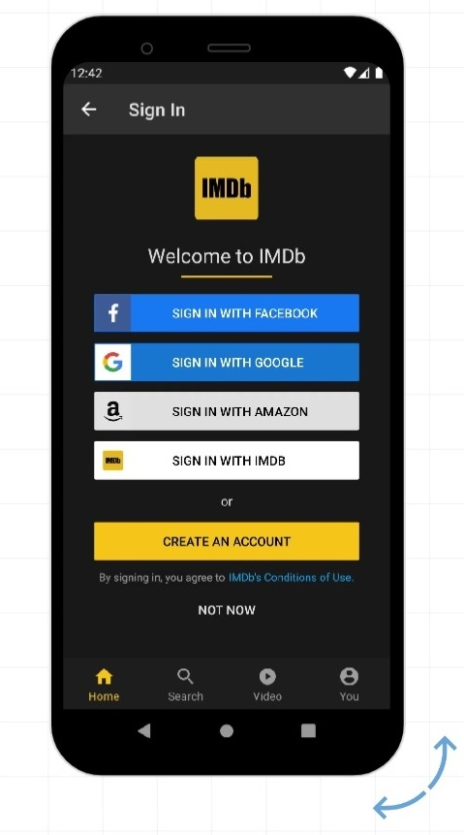
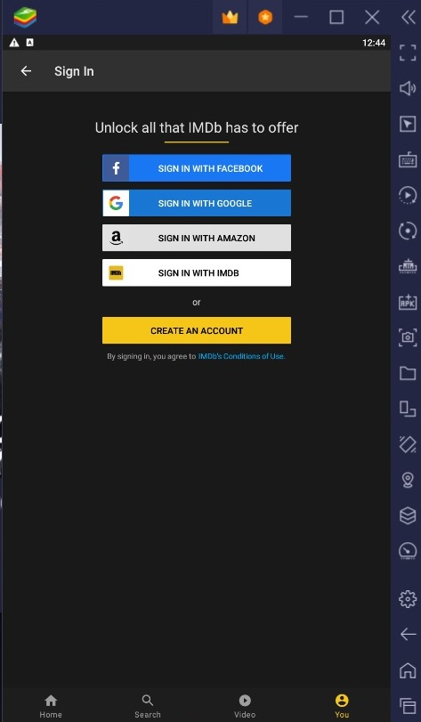
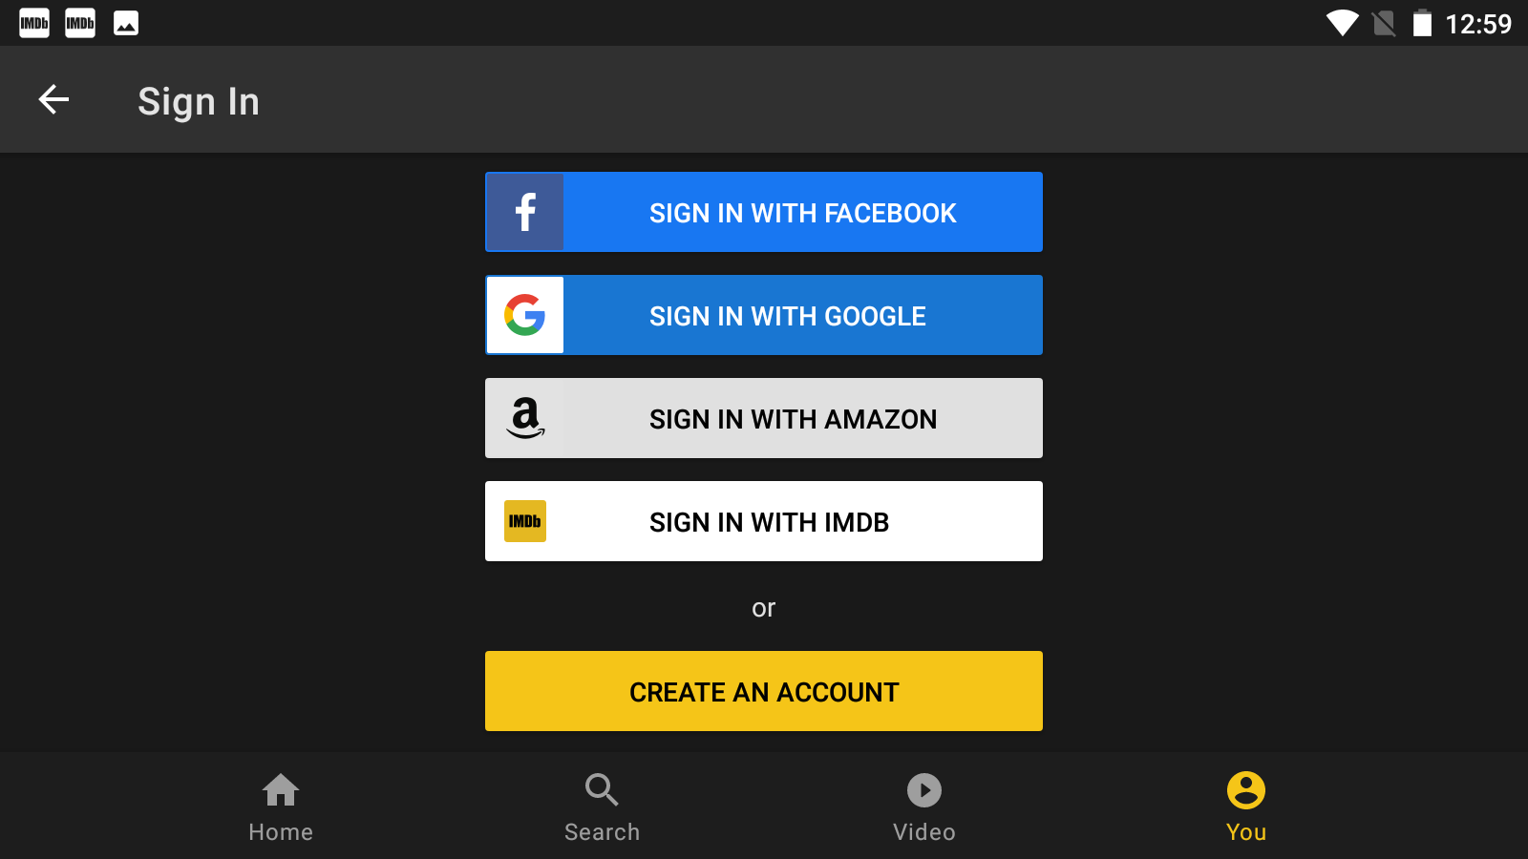



Environments
Android Emulators

Slide 6
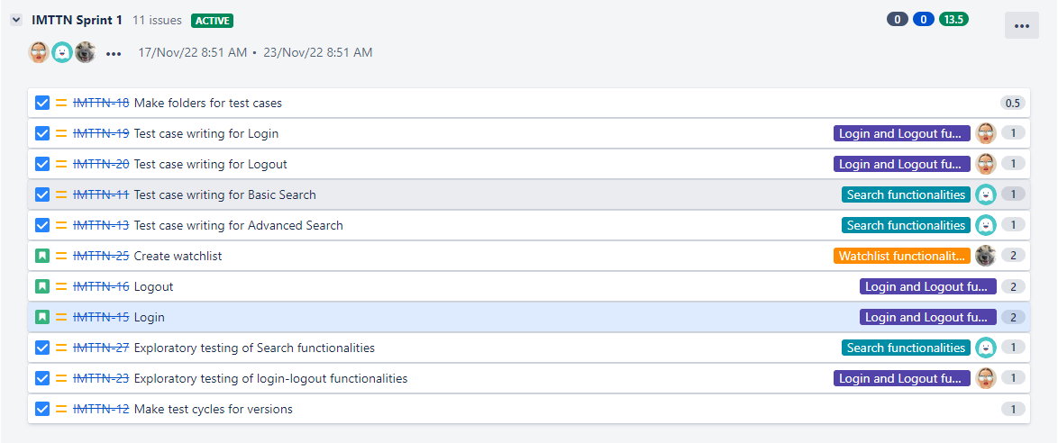

Sprints

Slide 7
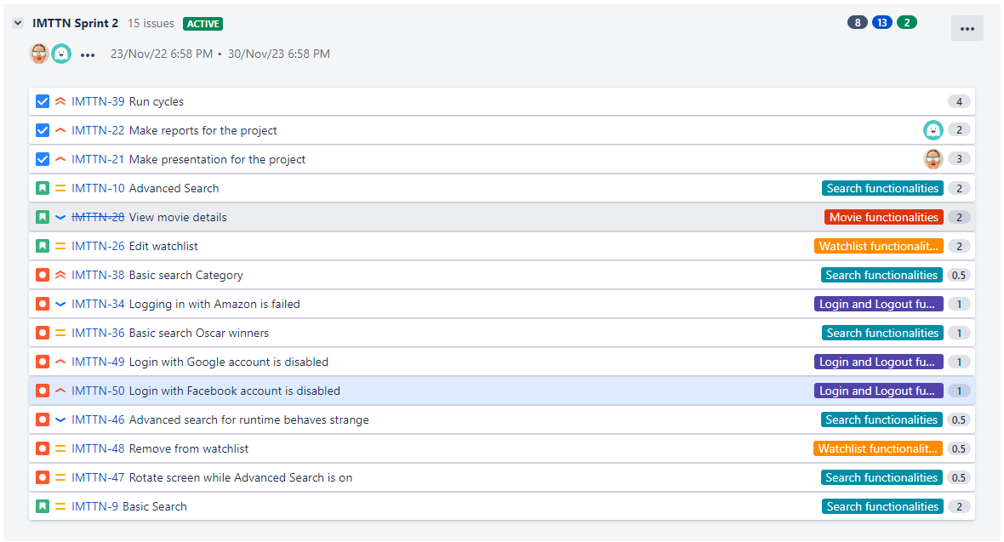
Sprints

Slide 8
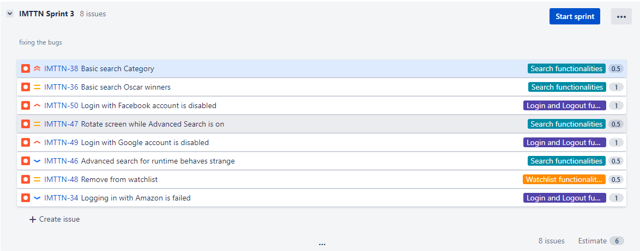
Sprints

Slide 9
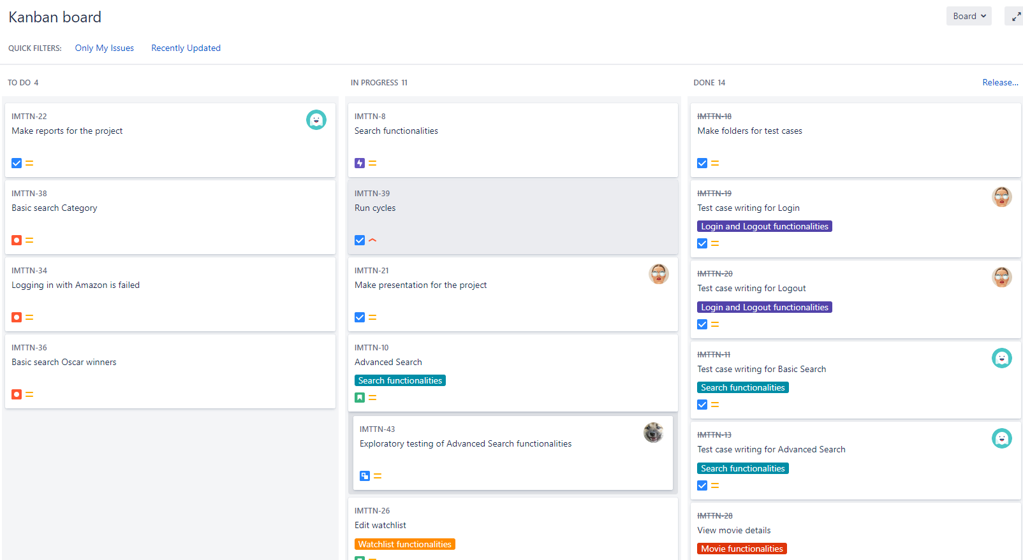
Kanban board

Slide 10
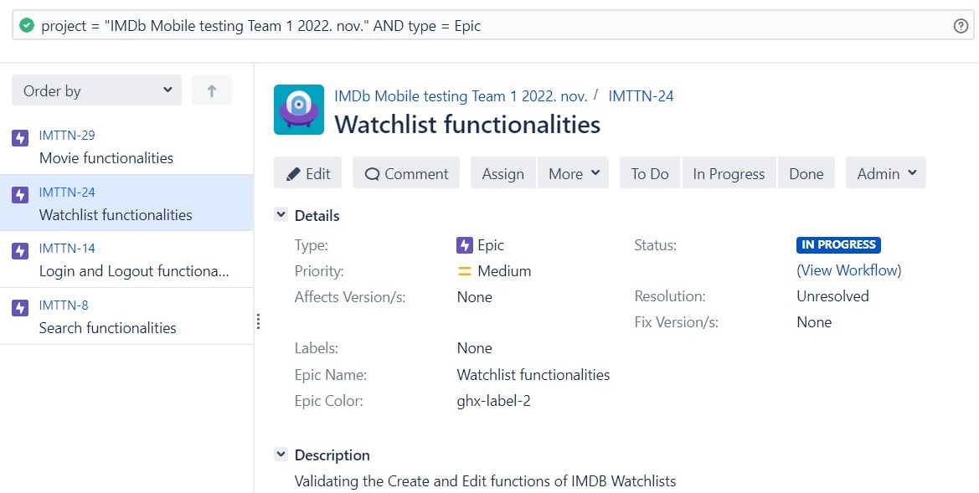
Epics

Slide 11

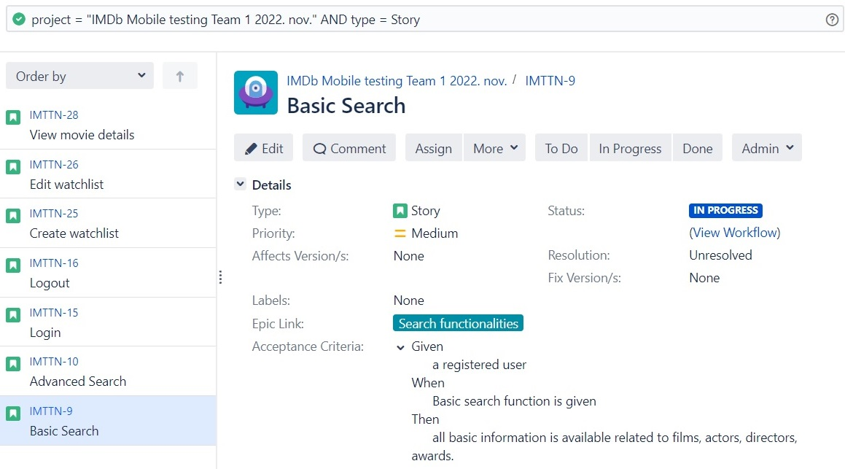

User stories

Slide 12
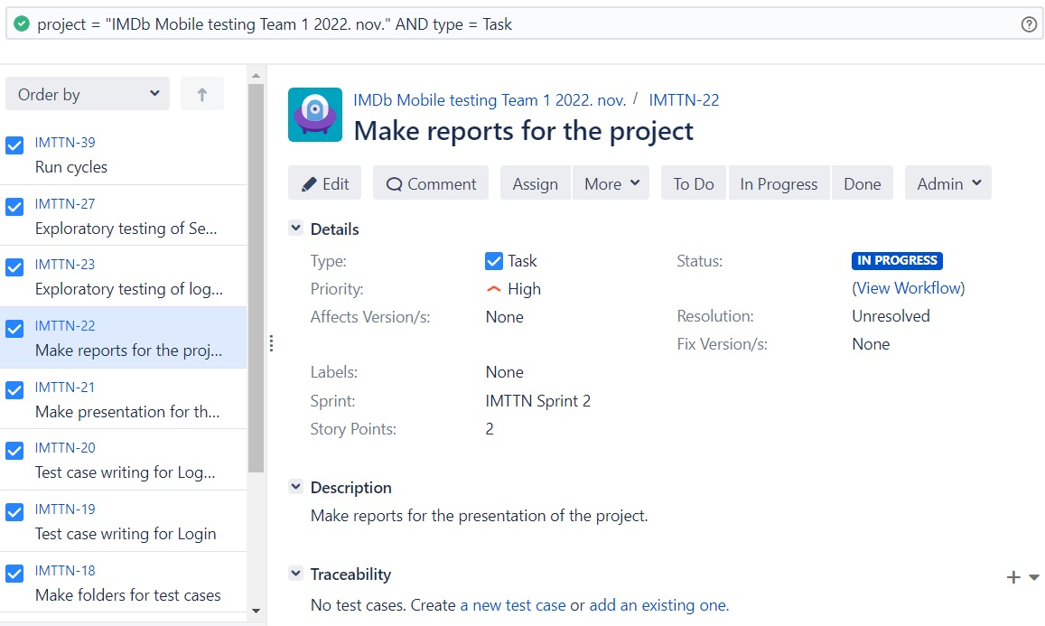
Tasks

Slide 13
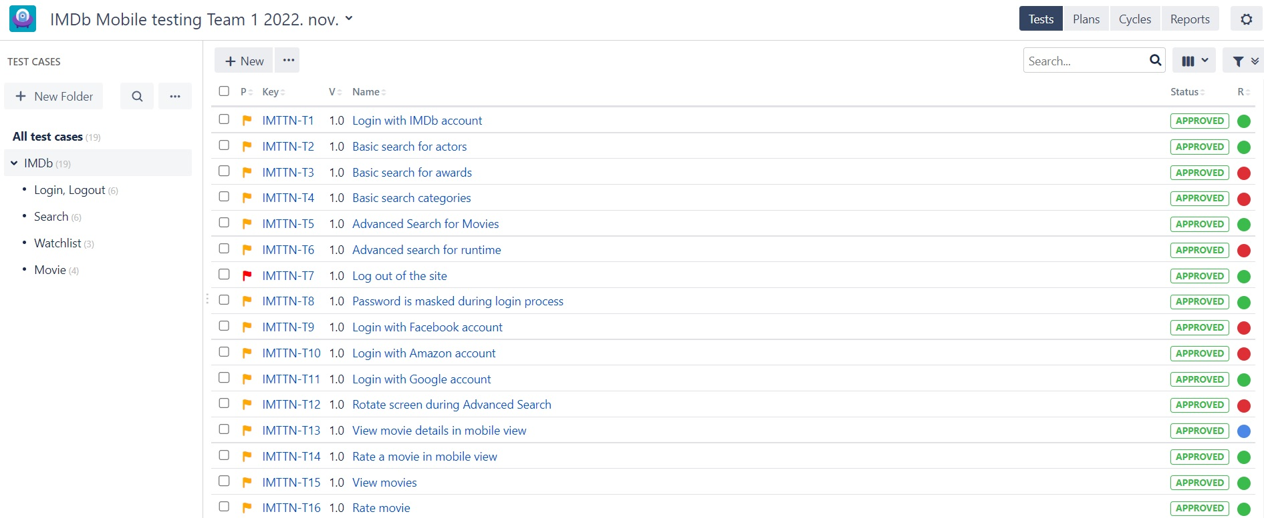
Test cases

Slide 14
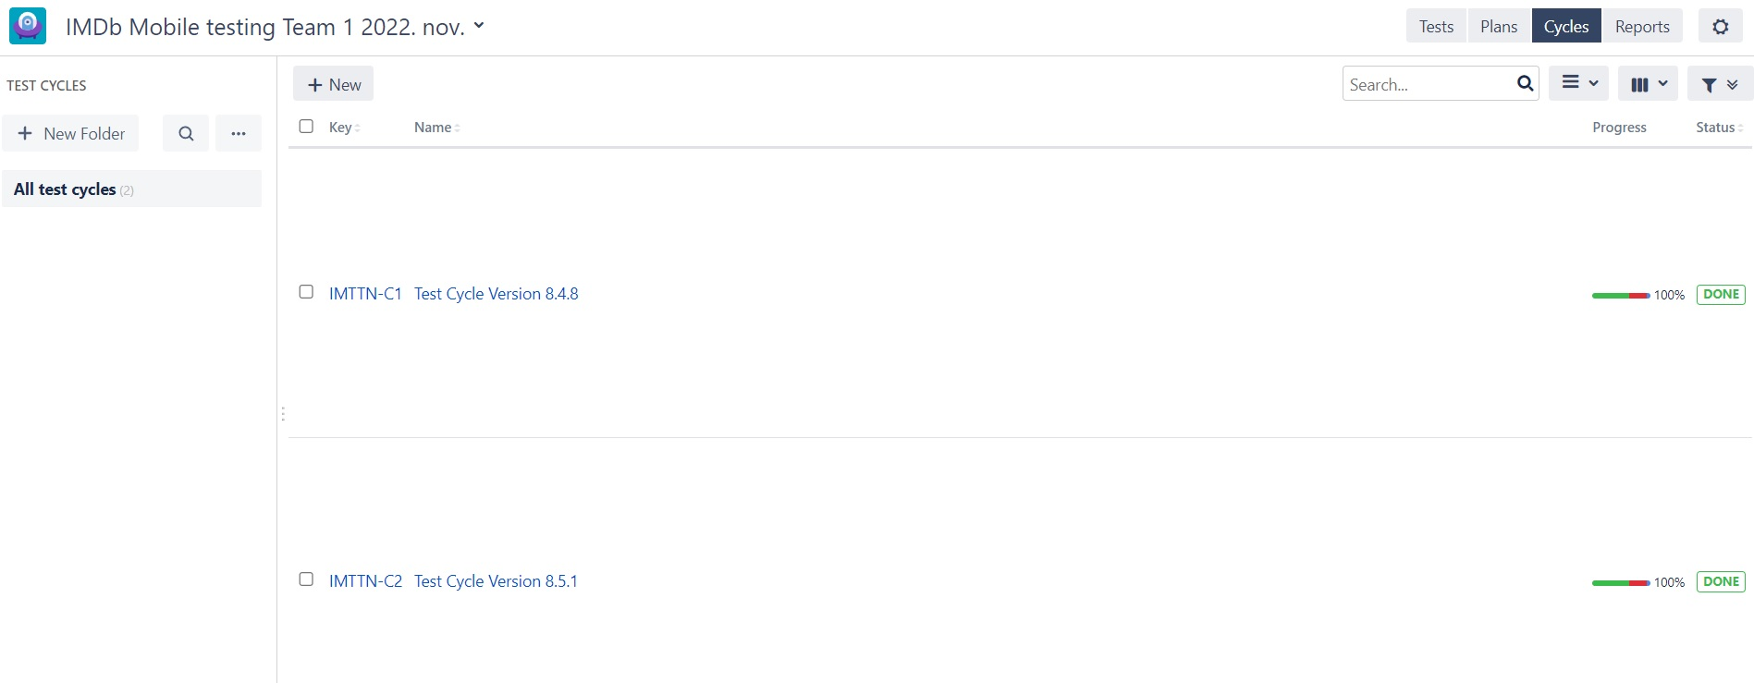
Test cycles

Slide 15
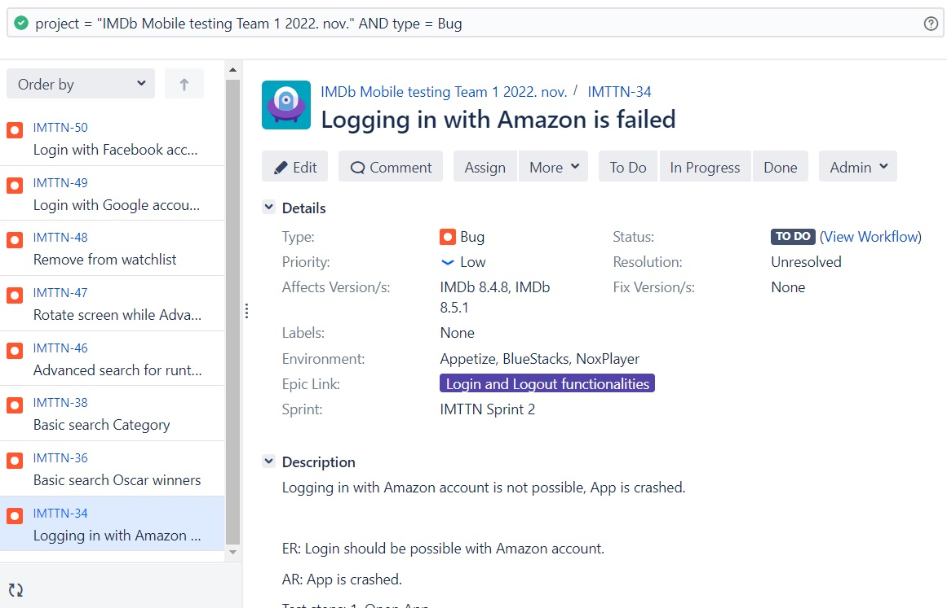
Bugs

Slide 16

Reports
Issues
Sprints
Test cases
Execution

Slide 17
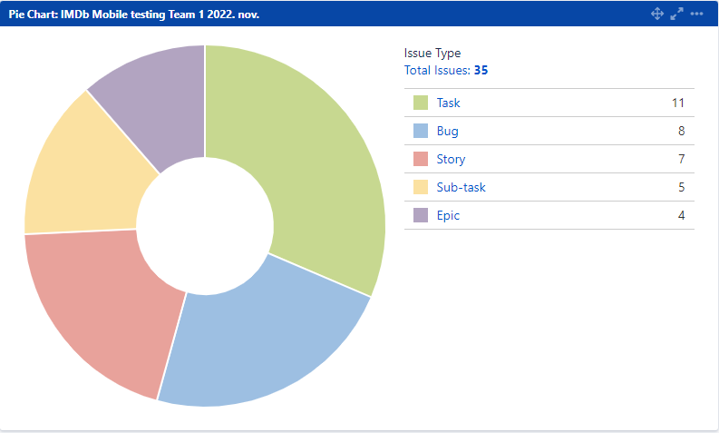
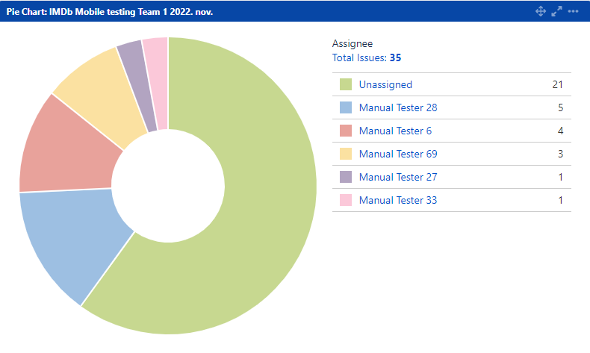
Issues

Slide 18
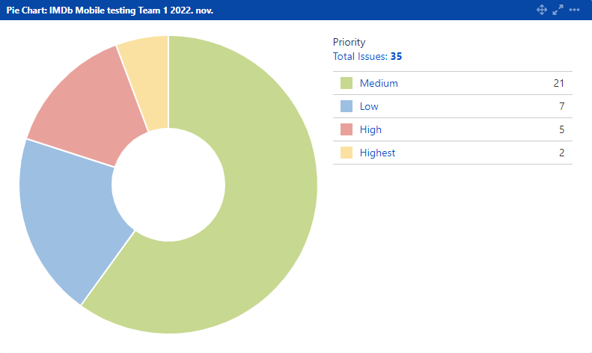
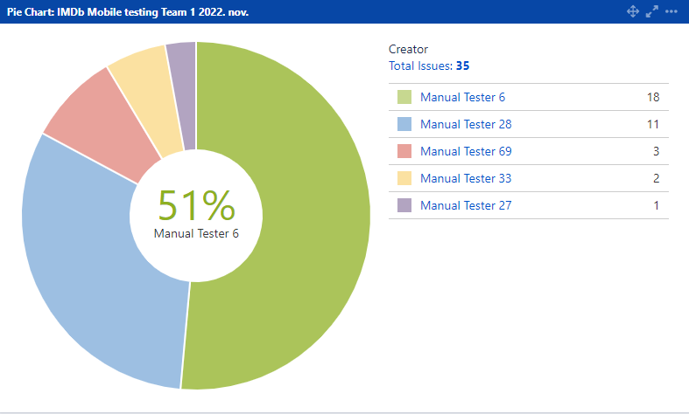

Slide 19
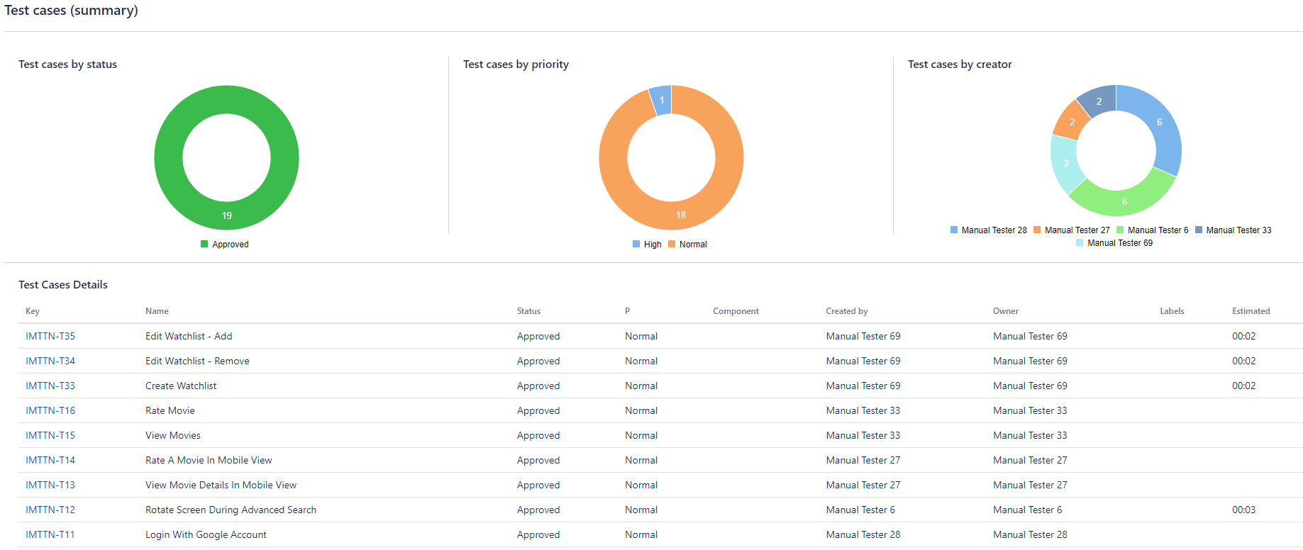
Test case summary

Slide 20
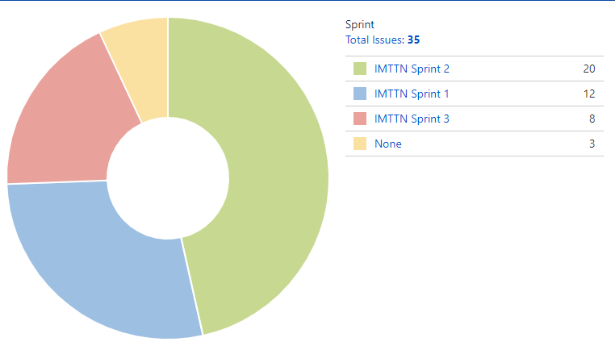

Sprint

Slide 21
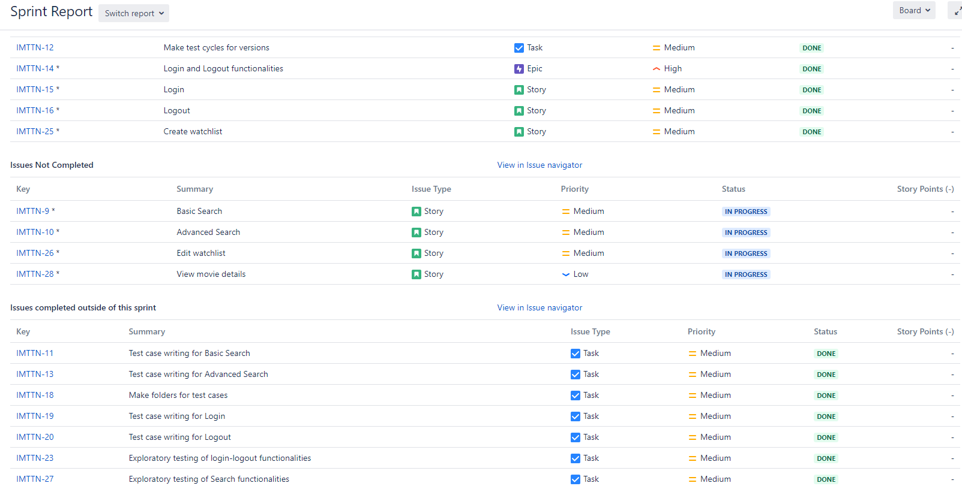

Slide 22
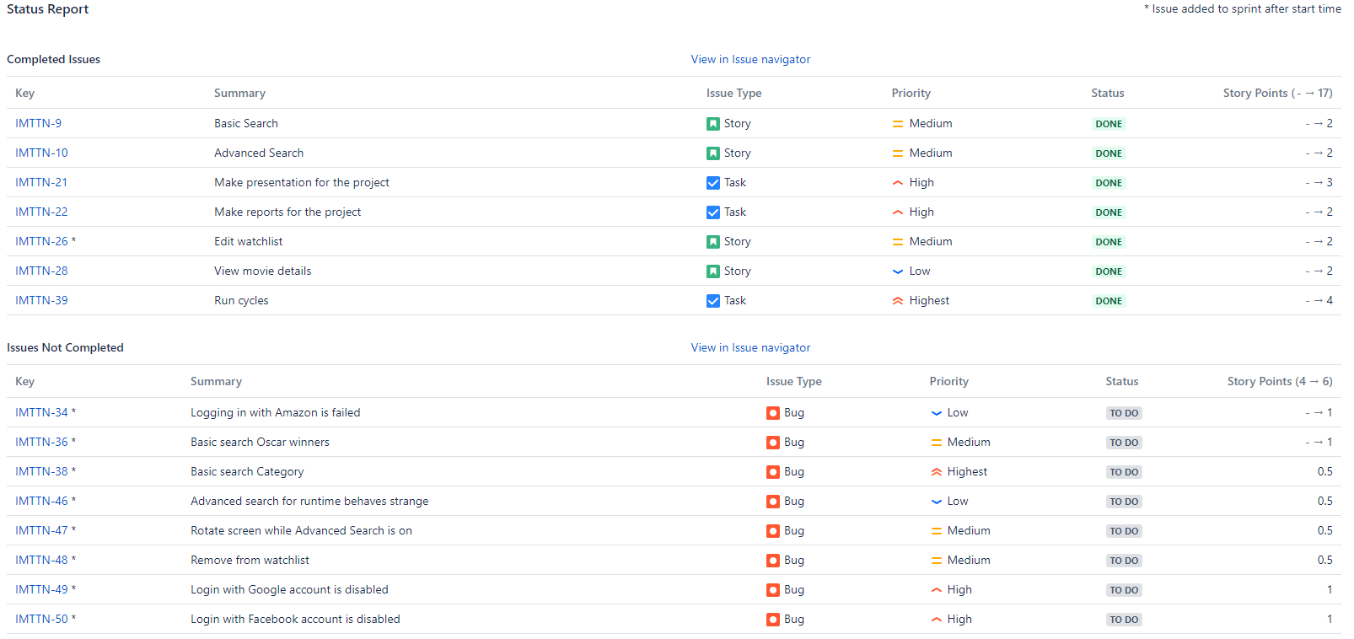

Slide 23
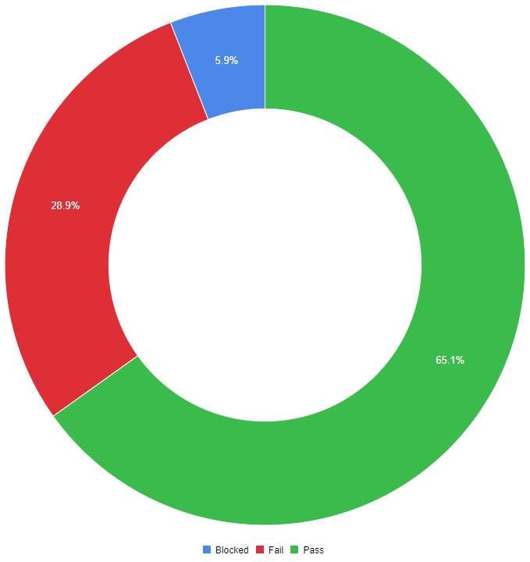
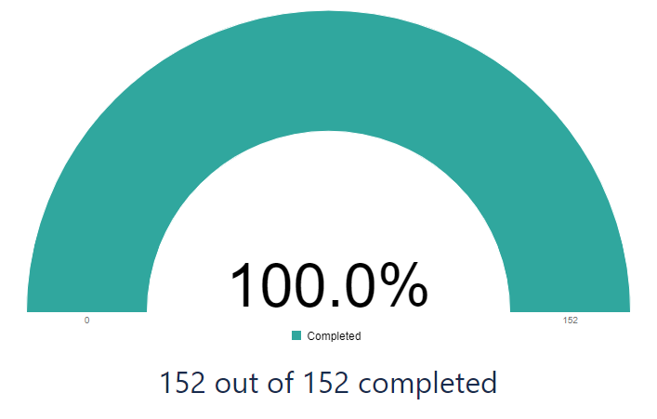
Execution
results

Slide 24
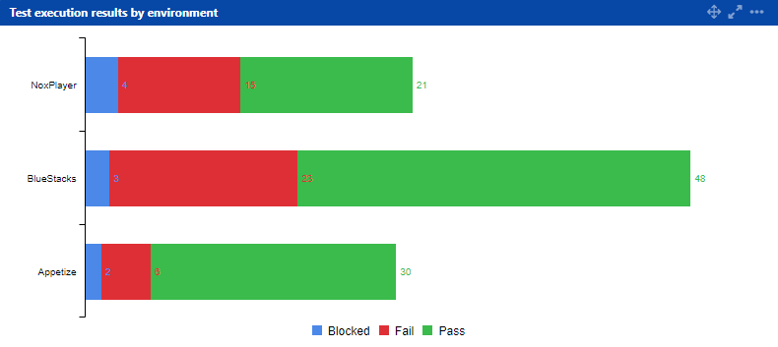
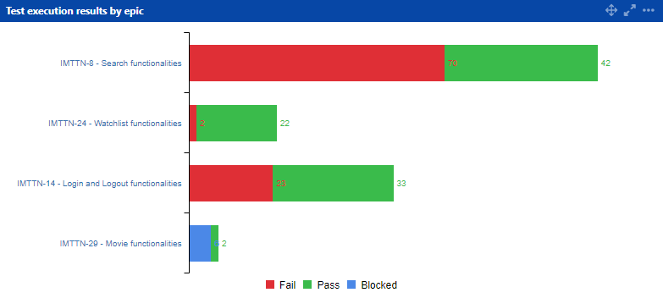

Slide 25
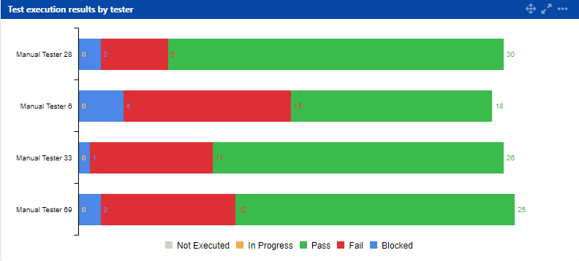
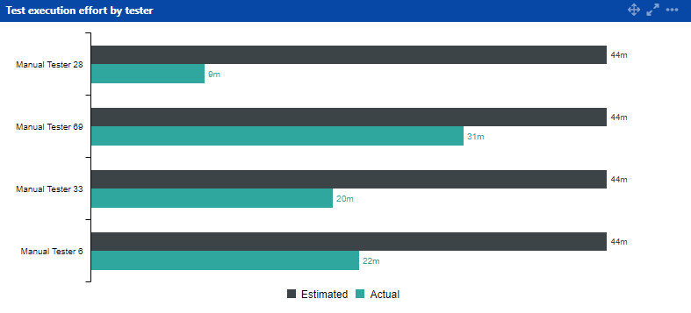
Effort

Slide 26
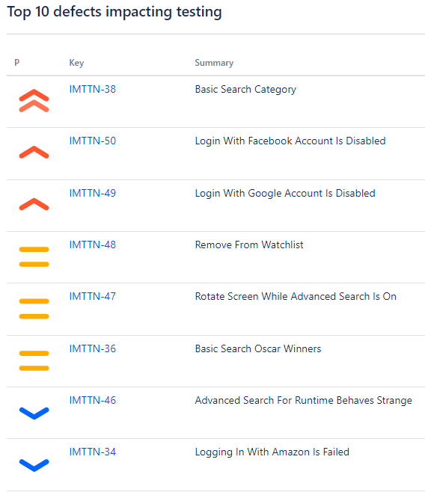

Slide 27
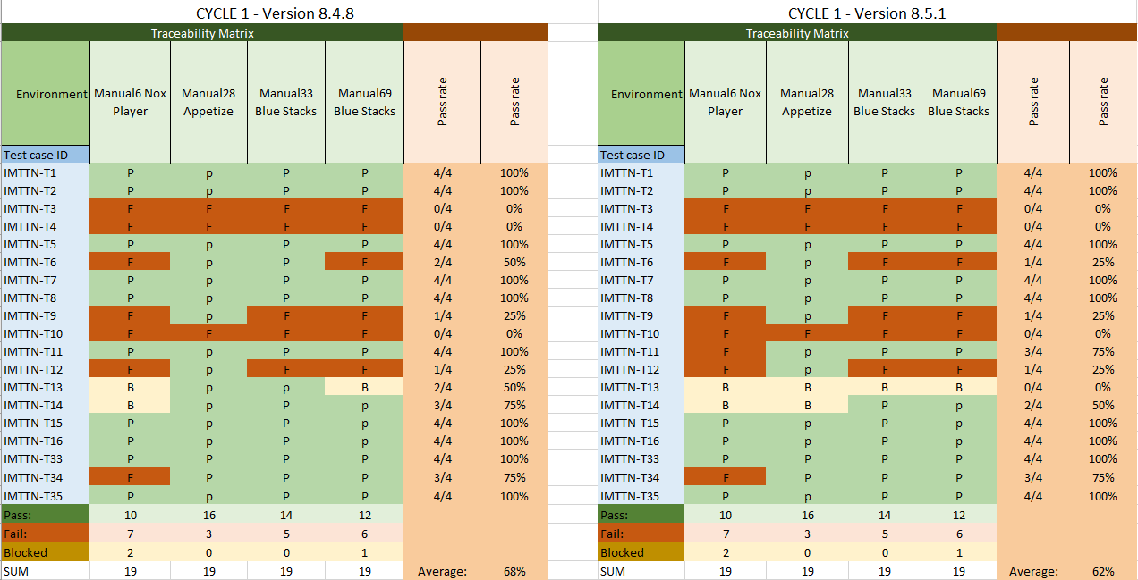

Slide 28



